Slide 1



Rohan Sundar - Sample BI Illustration - Pizza Shop Operations
View in Power BI
Last data refresh:
30/01/2024 11:42:30 UTC
Downloaded at:
09/02/2024 03:37:02 UTC

Slide 2
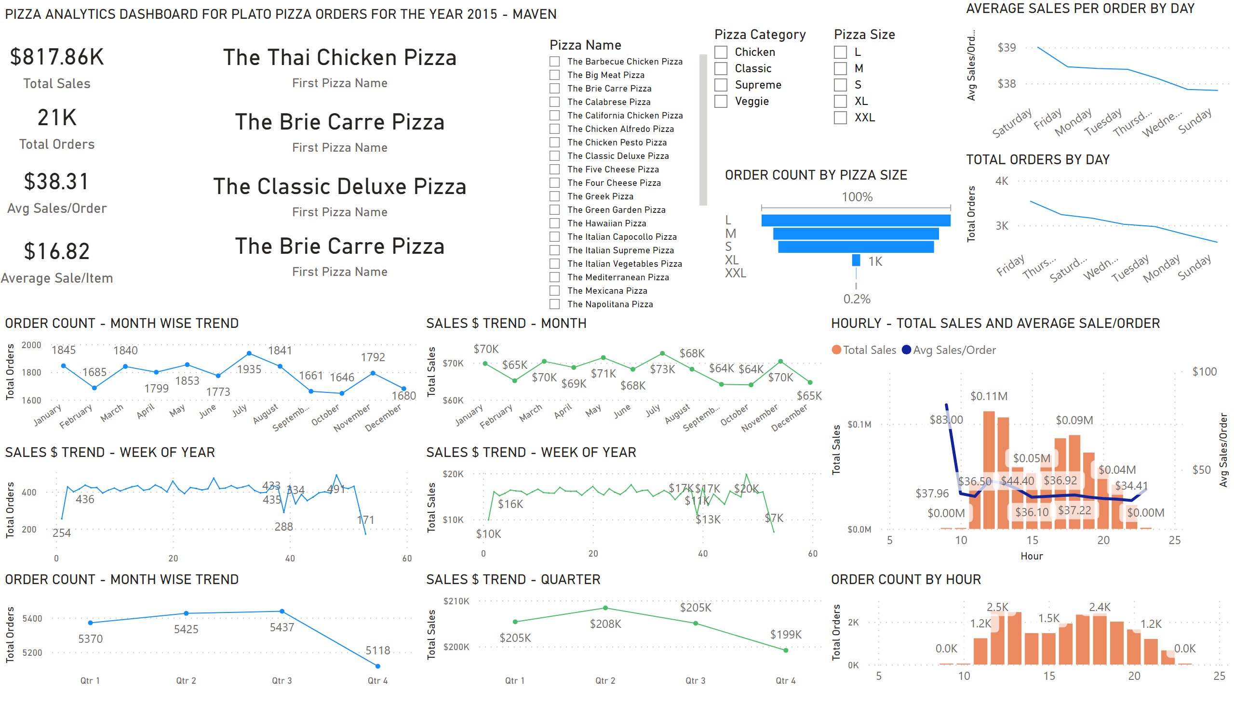
Sales Analysis
Notes:
ORDER COUNT BY HOUR
No alt text provided
TOTAL ORDERS BY DAY
No alt text provided
textbox
No alt text provided
ORDER COUNT - MONTH WISE TREND
No alt text provided
card
No alt text provided
card
No alt text provided
card
No alt text provided
card
No alt text provided
slicer
No alt text provided
slicer
No alt text provided
slicer
No alt text provided
ORDER COUNT BY PIZZA SIZE
No alt text provided
AVERAGE SALES PER ORDER BY DAY
No alt text provided
SALES $ TREND - MONTH
No alt text provided
SALES $ TREND - QUARTER
No alt text provided
SALES $ TREND - WEEK OF YEAR
No alt text provided
ORDER COUNT - MONTH WISE TREND
No alt text provided
SALES $ TREND - WEEK OF YEAR
No alt text provided
HOURLY - TOTAL SALES AND AVERAGE SALE/ORDER
No alt text provided
card
No alt text provided
card
No alt text provided
card
No alt text provided
card
No alt text provided

Slide 3
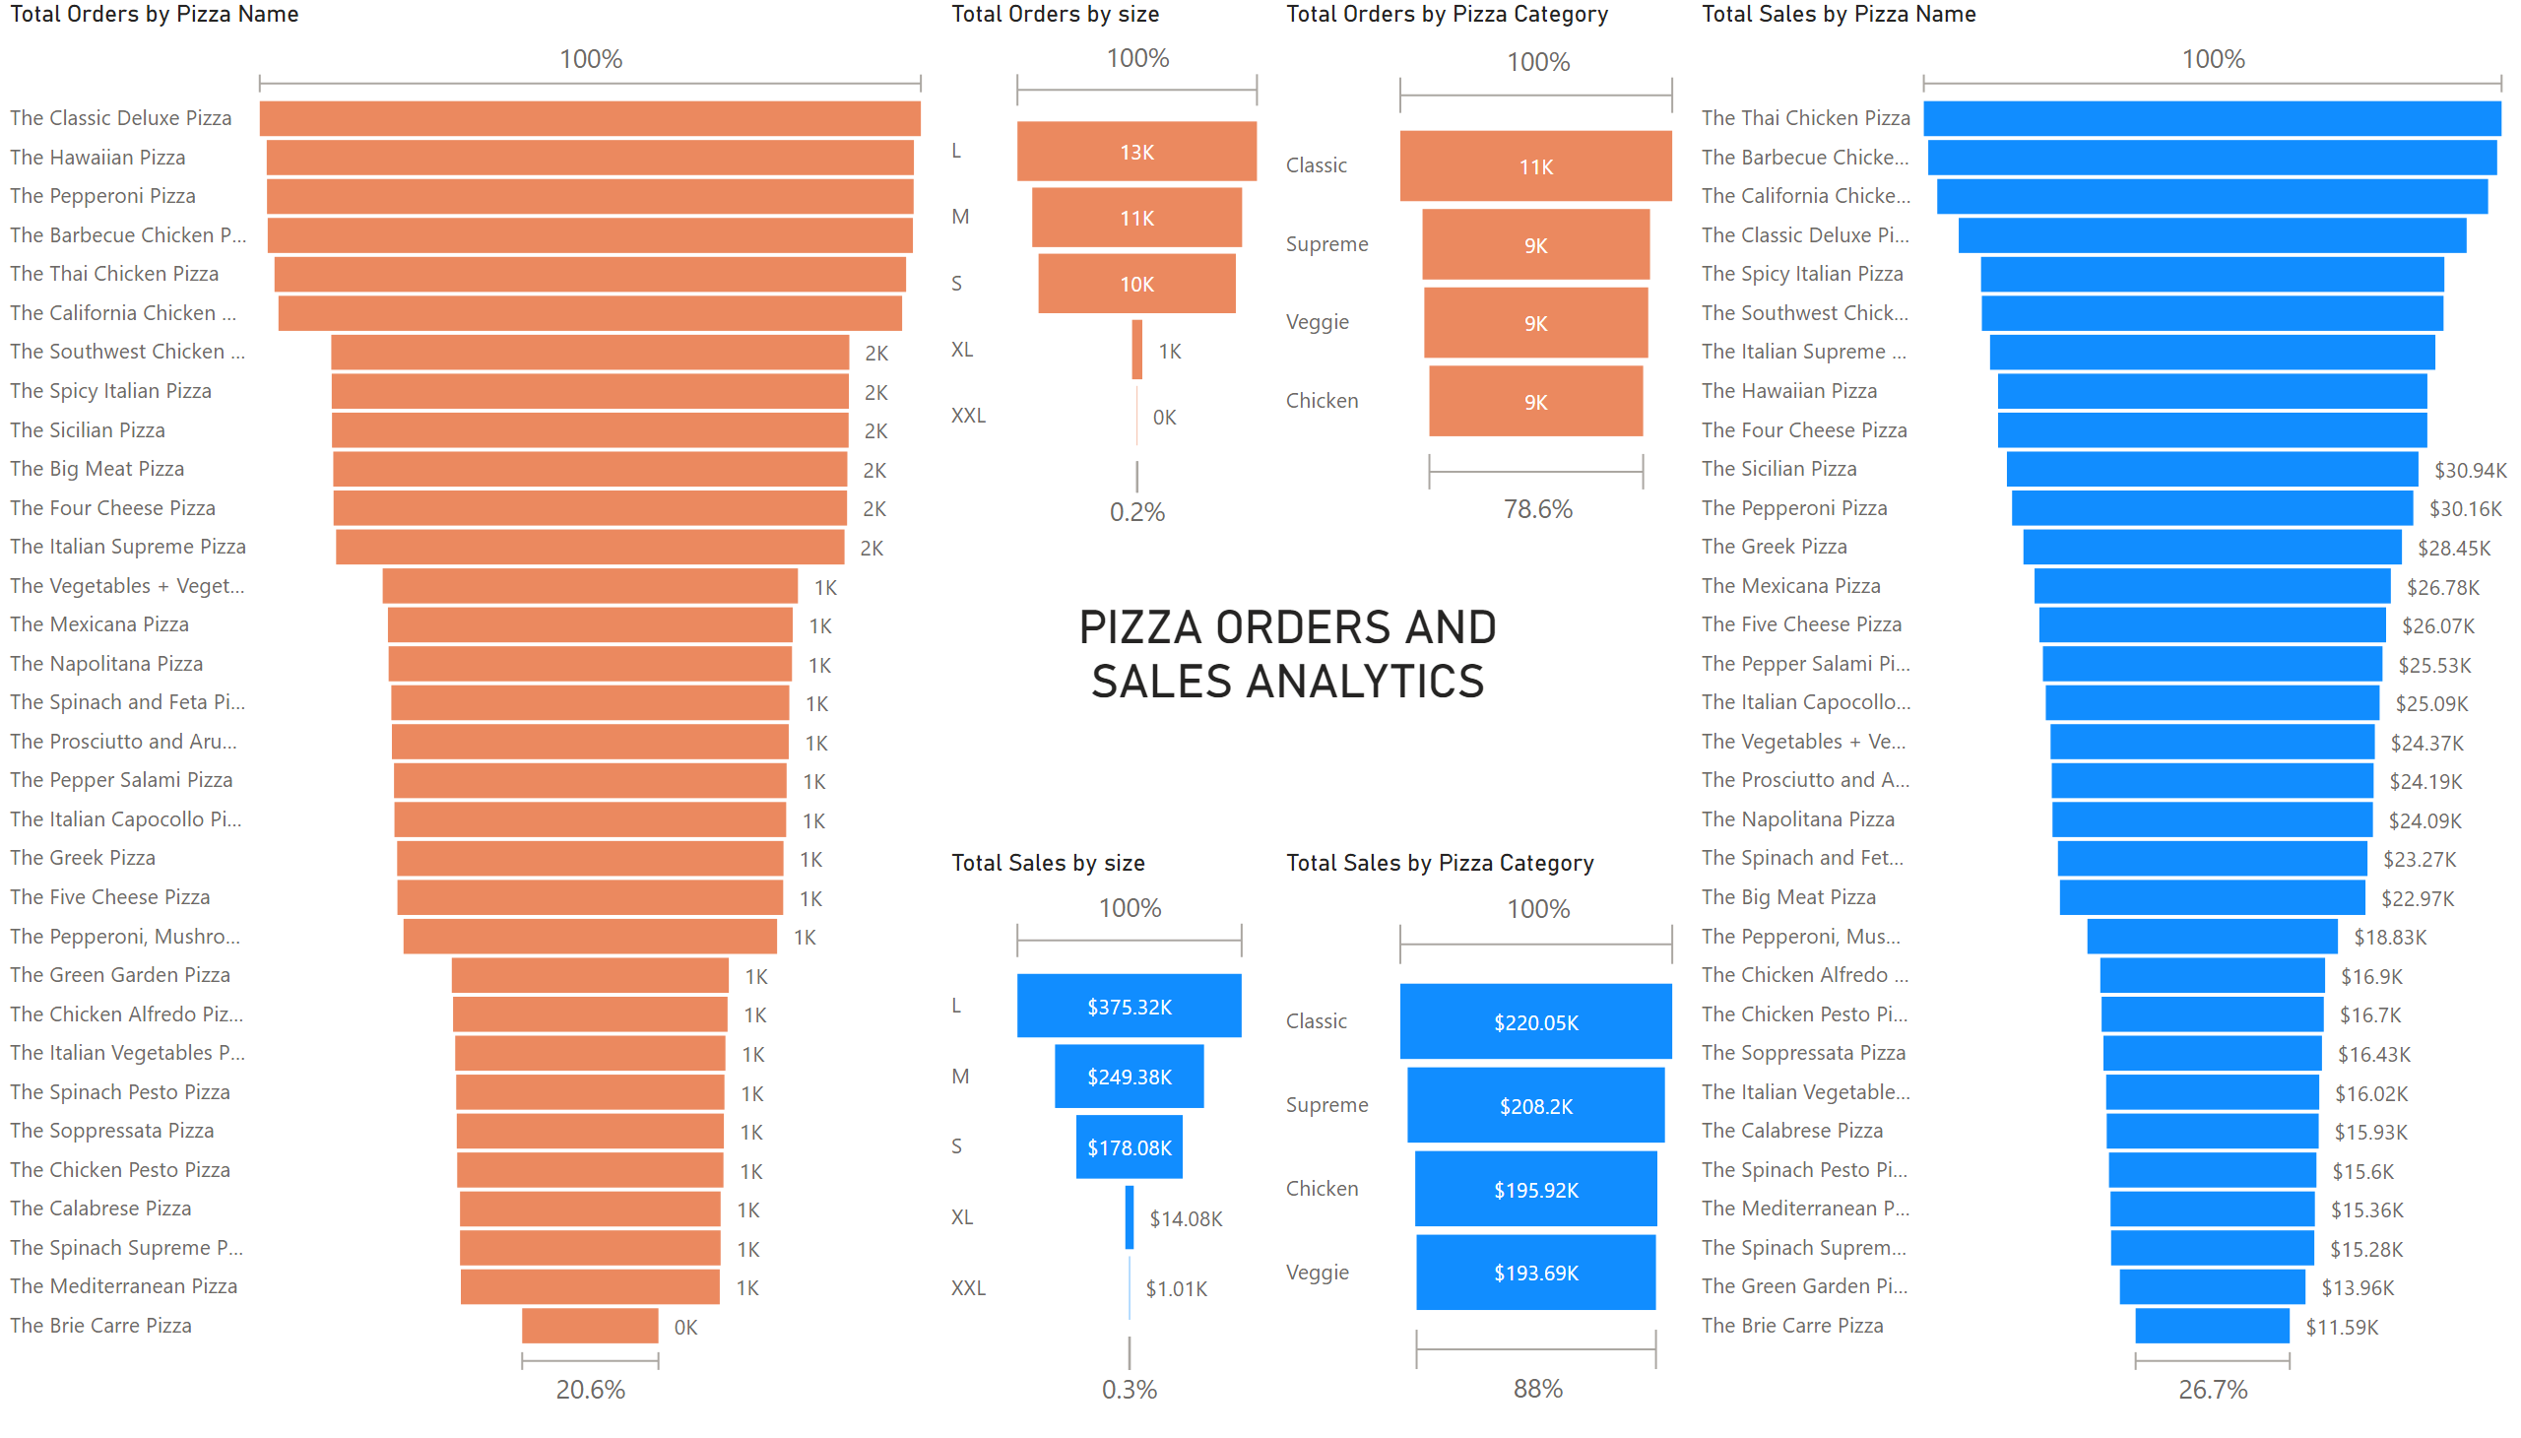
Pizza Analysis
Notes:
funnel
No alt text provided
funnel
No alt text provided
funnel
No alt text provided
funnel
No alt text provided
funnel
No alt text provided
funnel
No alt text provided
textbox
No alt text provided

Slide 4
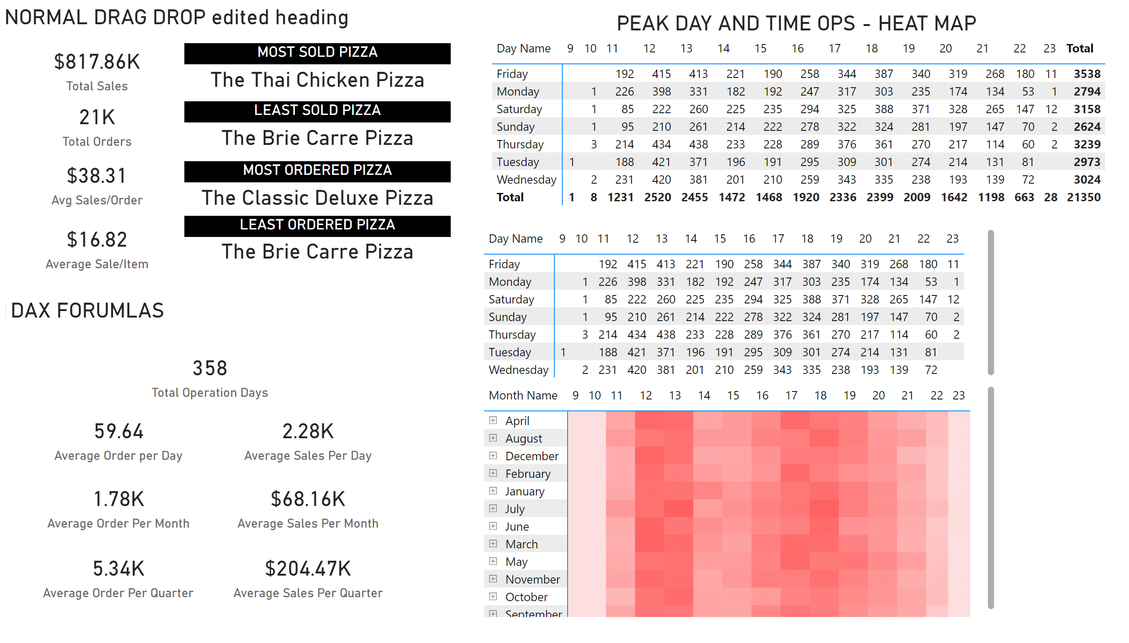
DAX-Avg/Month,QR
Notes:
card
No alt text provided
card
No alt text provided
card
No alt text provided
card
No alt text provided
card
No alt text provided
card
No alt text provided
card
No alt text provided
card
No alt text provided
card
No alt text provided
card
No alt text provided
card
No alt text provided
LEAST ORDERED PIZZA
No alt text provided
MOST ORDERED PIZZA
No alt text provided
LEAST SOLD PIZZA
No alt text provided
MOST SOLD PIZZA
No alt text provided
textbox
No alt text provided
textbox
No alt text provided
textbox
No alt text provided
textbox
No alt text provided
pivotTable
No alt text provided
pivotTable
No alt text provided
pivotTable
No alt text provided

